Slide 1

Lesson 3 - Dash

Slide 2
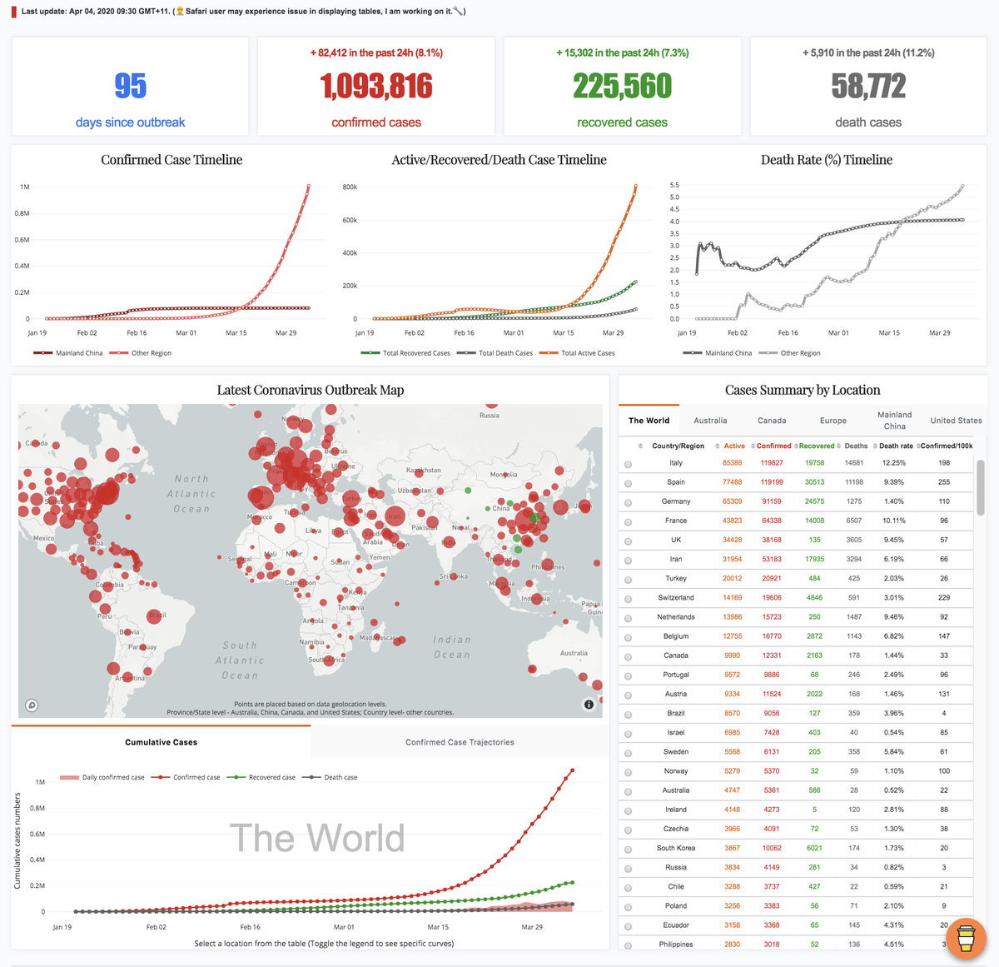

Dashboards
Dashboards are a good way to combine related visualisations together to give others a more complete view of your data.
They also give you the opportunity to add interactivity and letting the users explore data themselves.
Some dashboard uses:
Self exploration (as discussed above)
Model performance dashboard
Visualise a distribution with different parameters (use sliders to change parameters)

Slide 3
Model Performance Dashboard
Actual performance of the model (confusion matrix, ROC plot etc)
Statistics of the training/inference data (mean, mode, median, max, min, standard dev etc.)
Data Quality Report (e.g. Number of missings of each column by day)
Model training history (When the model was retained, when the in-production model was trained)
It might also be good to save different versions of your models, so you can compare new models with old ones on the same graph.

Slide 4
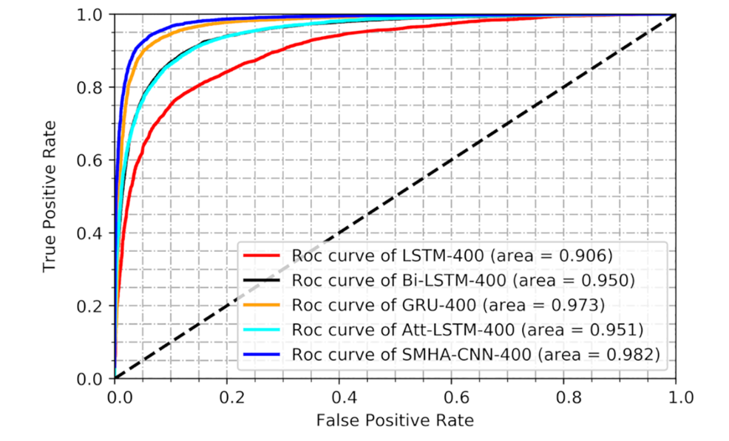
Model Performance Dashboard
Plotting the ROC of your different production models over time can be a good way of showing their improvement

Slide 5
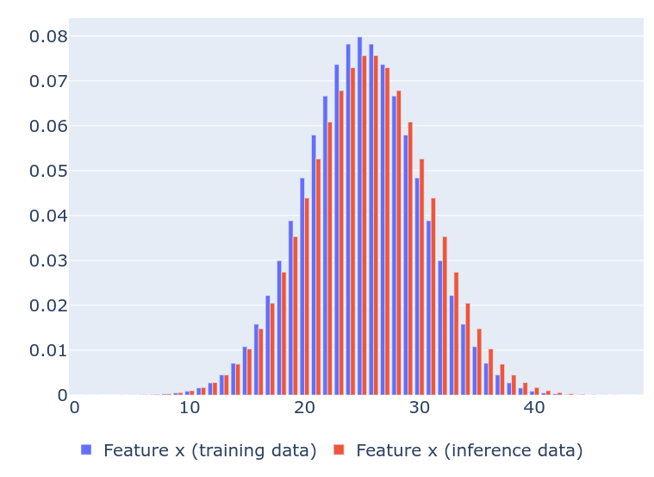
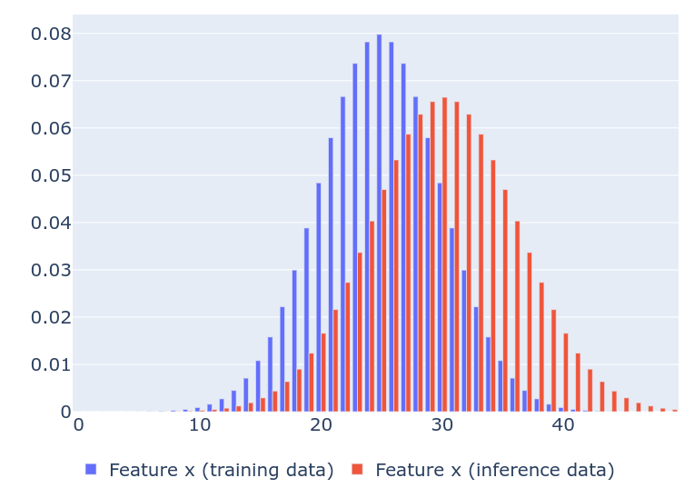
Model Performance Dashboard
Feature drift is a common issue that causes model performance to degrade over time

Slide 6
Intro to Dash
Dash lets you combine multiple graphs, along with components such as dropdown menus, sliders and buttons, to create interactive dashboards.
Dash runs as a self contained server, which can be hosted in a way that others can access it (useful for sharing insight)
The use of callbacks allow for huge flexibility in dashboard functionality

Slide 7
Dash App Structure
Dash apps are constructed from 2 parts:
The Layout Part - Everything that makes your app (buttons, text boxes, graphs..)
The Interactive Part - Here you add the logic for what happens when someone interacts with the components of your app (e.g. When they click a button).
You can make amazing dashboards by combining lots of simple pieces and having them interact with each other.

Slide 8
Hello World
hello_world.py
Create your own script with this code
Notes:
Do this interactively

Slide 9
The Layout Part
This is where we add our components (buttons, text boxes, sliders etc).
Most of these components have been premade and added to component libraries for you to use.
Components are split into 2 libraries;
HTML Components
Core Components
The layout part can be set by calling app.layout = …
The outer component usually starts with a html.Div object.

Slide 10
Dash HTML Components
Headers (html.H1, html.H2, html.Text etc)
Paragraph (html.P)
Division/Section(html.Div) <- You can also add text to this
Break (html.Br) <- This is line adding an empty line
Image (html.Img) - Paste the link of an image as the first argument
Button (html.Button)
There are many more covered in the documentation:
https://dash.plotly.com/dash-html-components

Slide 11
Dash Core Components
Graph - This component renders figures
Dropdowns
Check Lists
Sliders
Input Boxes
Radio Buttons
Download Components
Upload Components
Tabs
https://dash.plotly.com/dash-core-components

Slide 12
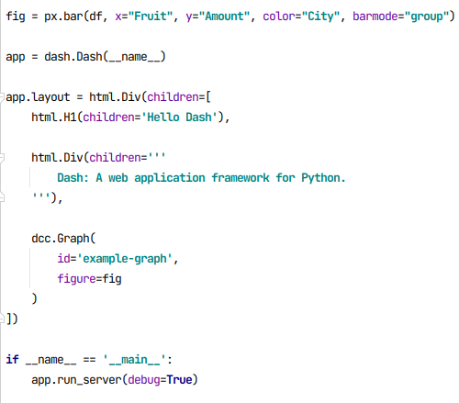
Adding Components and Starting the App
The top level element of app.layout is a usually html.Div component (but could be any component). The children attribute of this can be a list, and you add all of your components inside that list.
To start the app, simply call app.run_server()
It is best to put the run command in a main guard, which means the line will only run if we run the script (not if we import things from the script).
If you have no interactive components (like buttons and sliders) you don’t need to add anything else.
Try for yourself!
Notes:
df = pd.DataFrame({
"Fruit": ["Apples", "Oranges", "Bananas", "Apples", "Oranges", "Bananas"],
"Amount": [4, 1, 2, 2, 4, 5],
"City": ["SF", "SF", "SF", "Montreal", "Montreal", "Montreal"]
})

Slide 13
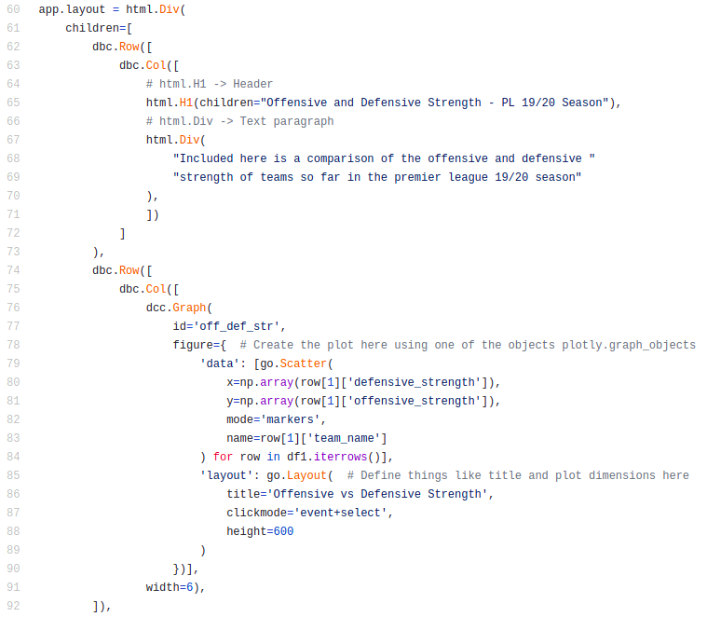
Organizing Components - Dash Bootstrap Components
As you add more components it can quickly become difficult to get them positioned correctly.
The dash_bootstrap_components library fixes this by adding Row() and Col() objects, which we can store our components inside.
Each components is stored inside a column, and each column is stored inside a row.

Slide 14
Organizing Components - Dash Bootstrap Components
Tips for setting up dbc:
set the first element of app.layout to dbc.Container()
add the dash bootstrap theme to the app
Use this script to help you:
hello_world_bootstrap.py

Slide 15
Try for yourself
Check out question 1 in the exercise sheet.

Slide 16
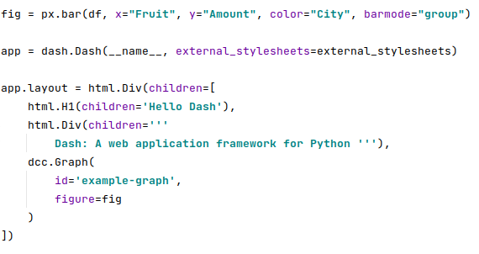
The Graph Component
Used for rendering figures (like the ones created with plotly express/graph objects
Main attributes
ID - How we refer to the graph object
figure - The plot itself
https://dash.plotly.com/dash-core-components/graph

Slide 17
Dash Core Components - Data Tables
Allows you to represent tables of data
Improve readability by specifying scroll bars in the style_table argument (overflowY).
import dash
import dash_table
import pandas as pd
df = pd.read_csv('https://raw.githubusercontent.com/plotly/datasets/master/solar.csv')
app = dash.Dash(__name__)
app.layout = dash_table.DataTable(
id='table',
columns=[{"name": i, "id": i} for i in df.columns],
data=df.to_dict('records'),
style_table={
‘height’: 500,
‘overflowY’: ‘auto’,
‘width’: 500
}
)
if __name__ == '__main__':
app.run_server(debug=True)

Slide 18
Tip: Reuse Components Where Possible
Utilize functions to help avoid writing the same code multiple times (general rule that applies to any type of coding).
This also makes your code much cleaner.
def generate_table(df, max_rows=10):
return dash_table.DataTable(
id='table',
columns=[{"name": i, "id": i} for i in df.columns],
data=df.head(max_rows).to_dict('records'),
)

Slide 19
DataFrame Task
Go to question 2 in the exercise sheet
Create a function for generating the data table.
Add a title to the dashboard (this will require you to redesign app.layout, check the hello_world.py example)
Change the height so that the DataFrame fits on the screen.
Add a vertical scroll bar
import dash
import dash_table
import pandas as pd
df = pd.read_csv('https://raw.githubusercontent.com/plotly/datasets/master/solar.csv')
app = dash.Dash(__name__)
app.layout = dash_table.DataTable(
id='table',
columns=[{"name": i, "id": i} for i in df.columns],
data=df.to_dict('records'),
)
if __name__ == '__main__':
app.run_server(debug=True)

Slide 20

Questions?
Notes:
30

Slide 21
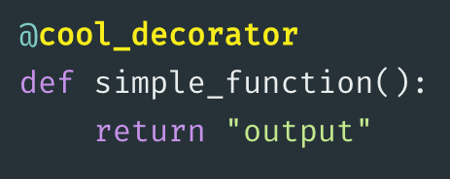
Introduction to Decorators
A decorator is a tool in python for extending the behaviour of an existing function.
A decorator is added to a function above the function declaration, using the @ symbol.
decorators.py

Slide 22
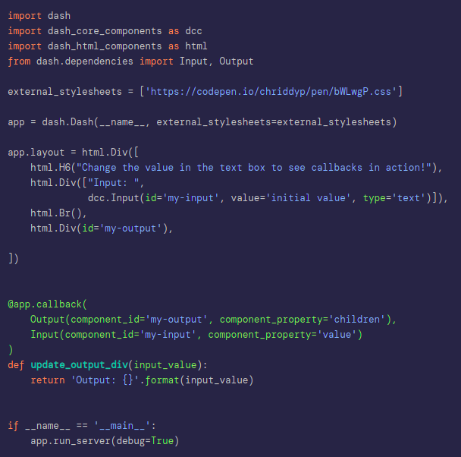
The Interactive Part
Dash uses callbacks to add interactivity to the components.
A function is turned into a callback when you define the app.callback decorator above it.
We give each component a unique id. In the callback we specify:
The id of the component that was interacted with by the user (the input)
The id of the component that will be acted upon (the output)
A function which contains all of the logic for doing what we want
dash_user_input.py

Slide 23
Core Component Walkthroughs
Notes:
30

Slide 24
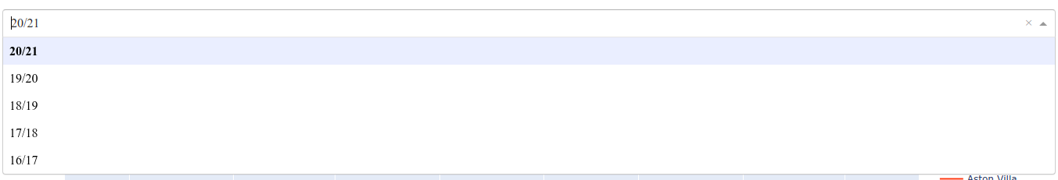
Dash Core Components - Dropdown
Arguments:
ID - The unique name given to the component
Options - A dictionary containing ‘label’ (the value the user sees) and ‘value’ which is the real value that label represents.
Value - Default option
https://dash.plotly.com/dash-core-components/dropdown
dcc.Dropdown(
id = 'season_dropdown',
options = [
{'label': '20/21', 'value': '2021'},
{'label': '19/20', 'value': '1920'},
{'label': '18/19', 'value': '1819'},
{'label': '17/18', 'value': '1718'},
{'label': '16/17', 'value': '1617'}
],
value = '20/21'
)

Slide 25
Worked Example - Filter for different states
Take the dataframe script you created before and add a dropdown menu that lets us filter for different states, and show their data in a DataFrame on the dashboard.
The DataFrame should update when different buttons are pressed.
“We need a callback that takes the dropdown menu as an input, and has the DataFrame as an output”

Slide 26
Dash Core Components - Sliders
Useful when you have a range of values, such as the date, some kind of cut-off point or a parameter of a probability distribution.
There are 2 Types of slider:
dcc.Slider - Single point
dcc.RangeSlider - 2 points
app = dash.Dash(__name__, external_stylesheets=external_stylesheets)
app.layout = html.Div([
dcc.Slider(
id='my-slider',
min=0,
max=20,
step=0.5,
value=10,
),
html.Div(id='slider-output-container')
])
Notes:
60

Slide 27
Dash Core Components - Tab
Tabs create multiple pages on our dashboard, just like you have in a web browser.
app = dash.Dash(__name__, external_stylesheets=external_stylesheets)
app.layout = html.Div([
dcc.Tabs(id='tabs-example', value='tab-1', children=[
dcc.Tab(label='Tab one', value='tab-1'),
dcc.Tab(label='Tab two', value='tab-2'),
]),
html.Div(id='tabs-example-content')
])
@app.callback(Output('tabs-example-content', 'children'),
Input('tabs-example', 'value'))
def render_content(tab):
if tab == 'tab-1':
return html.Div([
html.H3('Tab content 1')
])
elif tab == 'tab-2':
return html.Div([
html.H3('Tab content 2')
])
Notes:
60

Slide 28
Automatically Updating Components
This is very useful if you want to visualise a constant stream of data, such as a model training process or an event that is already in progress.
We can achieve this with the dcc.Interval component.
This component can be used to periodically update one or more figures.
app = dash.Dash(__name__, external_stylesheets=external_stylesheets)
app.layout = html.Div(
html.Div([
html.H4('TERRA Satellite Live Feed'),
html.Div(id='live-update-text'),
dcc.Interval(
id='interval-component',
interval=1*1000, # in milliseconds
n_intervals=0
)
])
)
@app.callback(Output('live-update-text', 'children'),
Input('interval-component', 'n_intervals'))
def update_metrics(n):
lon, lat, alt = satellite.get_lonlatalt(datetime.datetime.now())
style = {'padding': '5px', 'fontSize': '16px'}
return [
html.Span('Longitude: {0:.2f}'.format(lon), style=style),
html.Span('Latitude: {0:.2f}'.format(lat), style=style),
html.Span('Altitude: {0:0.2f}'.format(alt), style=style)
]

Slide 29
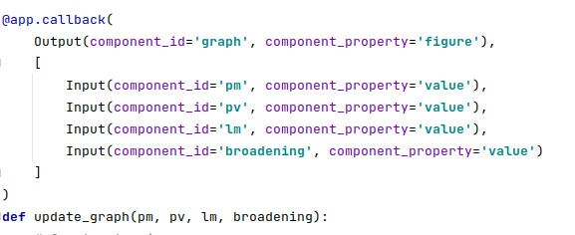
Multiple Inputs
It is possible to have multiple inputs to a callback. In this case, if any input is triggered, the update function is activated.

Slide 30
Multiple Outputs
It is possible to have multiple outputs. This is useful when you want to, for example, update multiple graphs that share a common parameter.

Slide 31


Slide 32
Task - Comparing Different Probability Distributions
We want to see the effect of a distributions parameters (such as the mean and standard deviation) on its shape.
We have a function that takes :
The mean and standard deviation of a normal distribution
And outputs a bar chart showing that distribution.
Build a dashboard with sliders for the mean and standard deviation, with a graph at the bottom that displays the distribution.
There is a drawing on the next slide to give a rough idea of the layout
You can find the starting code and more help in question 3 of the exercise sheet.

Slide 33
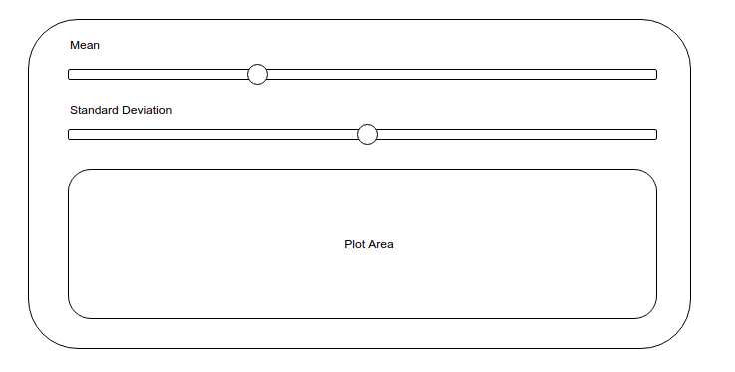
Task - Comparing Different Probability Distributions

